Slide 1
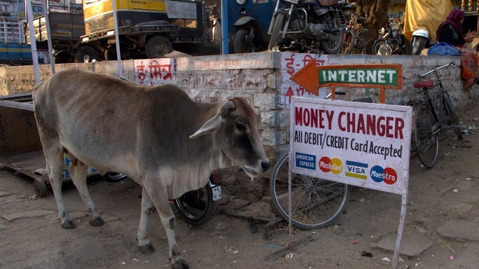
Class 5:
Distributed Consensus
Cryptocurrency Café
UVa cs4501 Spring 2015
David Evans

Slide 2
Plan for Today
Hashing
Preventing Double Spending
DigiCash – Untraceable Cash
Distributed Consensus
Project 1 is due Friday (11:59pm)
Upcoming office hours:
Me: Thursday 4-5pm (Rice 507)
Nick: Friday noon-2pm (HackCville)

Slide 3
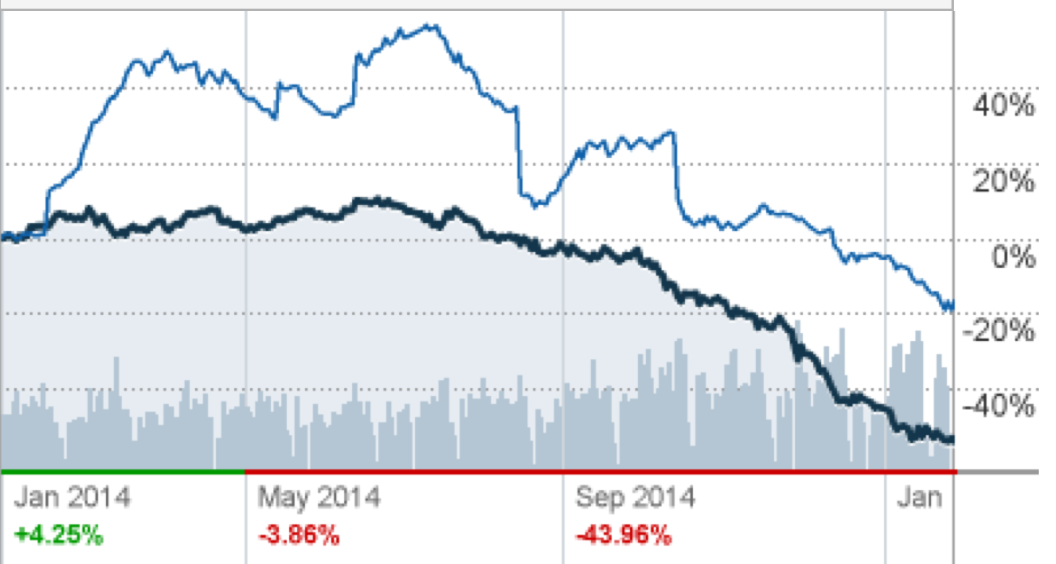
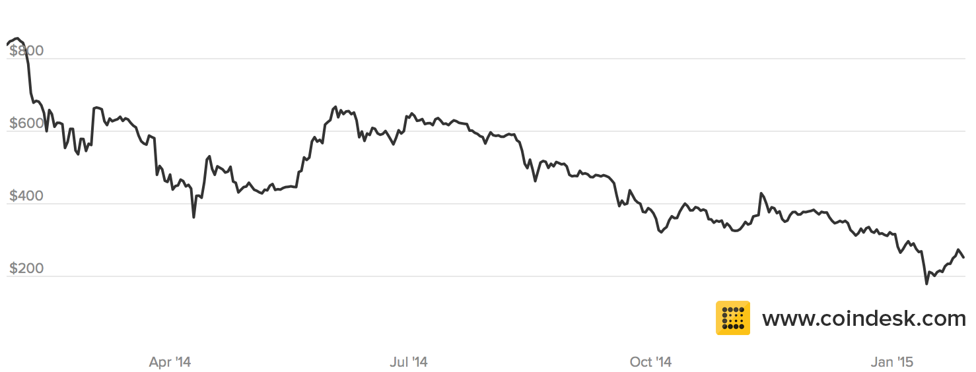
Price Volatility

Slide 4
Size of Bitcoin
Apple’s Profits
(last 3 months) = $18B
(Revenues = $75B)
Value of all Bitcoin at today’s price: $3.5B

Slide 5
Size of Bitcoin
US National Debt: $18.1 T

Slide 6
Using Asymmetric Crypto: Signatures
Anyone
Bob
Get KU_{B} from trusted provider
Generates key pair: KU_{B}, KR_{B}
Publishes KU_{B}
Verified
Message
E
Signed Message
D
Message
Insecure Channel
KU_{B}
KR_{B}

Slide 7

Signing Long Messages
Alice signs m₁ = { “I give coin x = KU_{A}, t to address KU_{B}.”} with KR_{A}.
Bob signs m₂ = { “I give coin x = KU_{A}, t, given to me by m₁to address KU_{C}.”} with KR_{B}.
Asymmetric crypto is expensive: what is the longest m we can sign with 256-bit ECDSA?

Slide 8
Message Digests
Alice
Bob
H
=
Message
Signed Message
Verified
Message
Digest
E
D
H
Verified
Message
Message
Message Digest
KU_{B}
KR_{B}
H is a cryptographic hash function:
one-way: given H(x) cannot find preimage x
strong collision-resistant:
hard to find pair x and y where H(x) = H(y)

Slide 9
Hash Functions
P₂
P_{n}
P₁
⊕
⊕
⊕
IV
...
K
E
E
K
E
C₂
C_{n}
C₁
Cipher Block Chaining

Slide 10
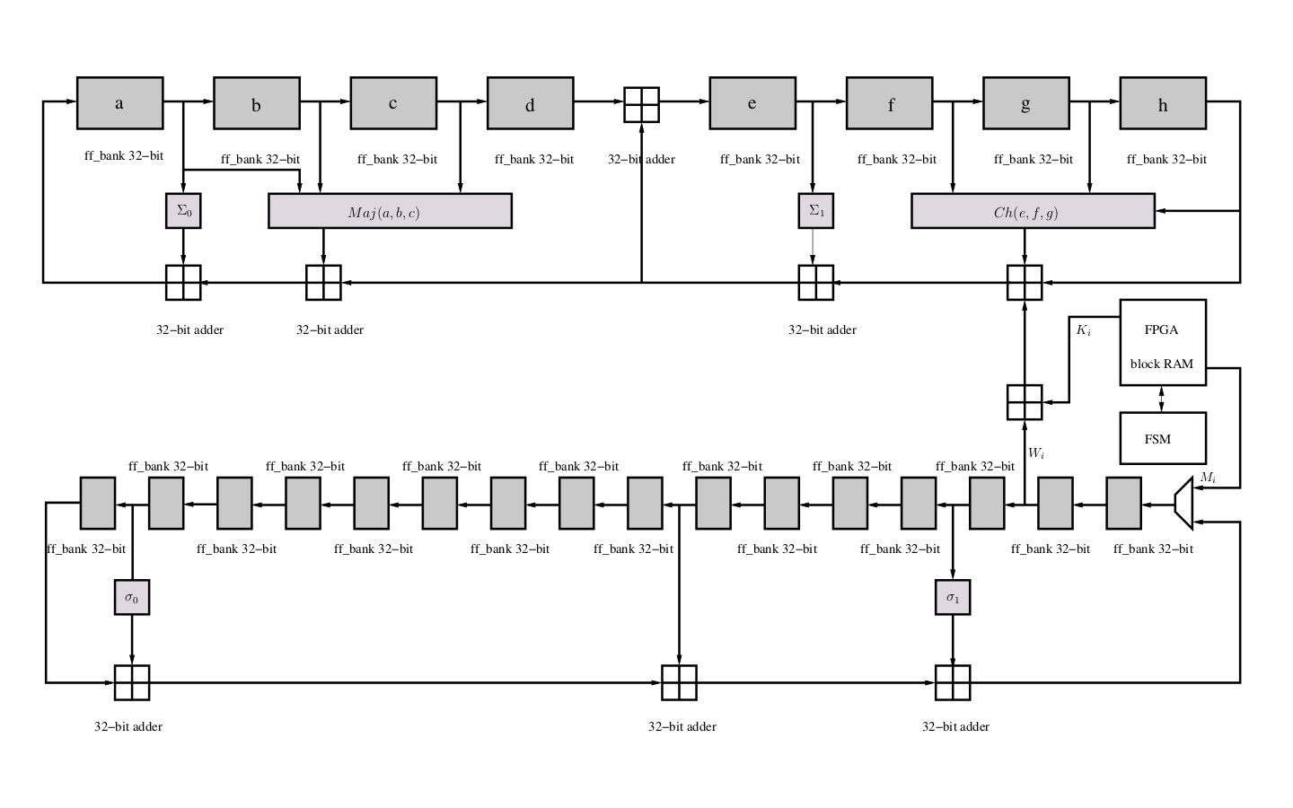
SHA-2
SHA-256
256-bit output
64 rounds
(best known attacks break preimage resistance for 52 rounds)
http://opencores.org/project,sha256core

Slide 11
Cryptographic Hashing in Bitcoin
Transactions: message digests for signatures
Public address: hash of public key
Blockchain

Slide 12
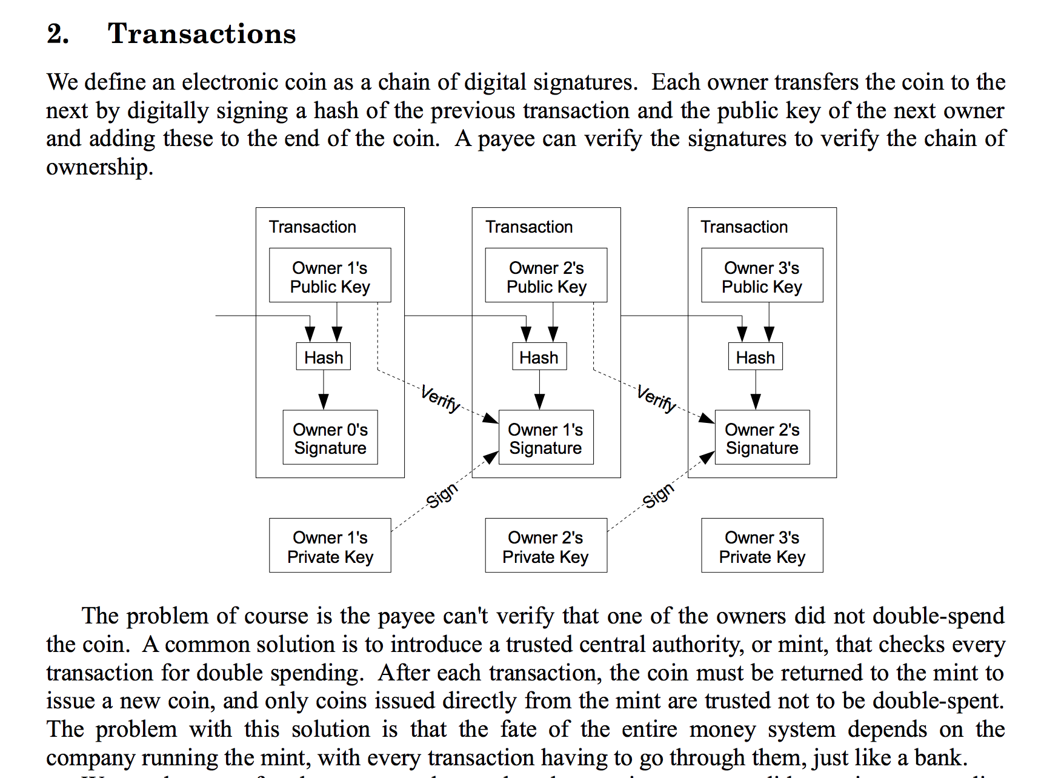
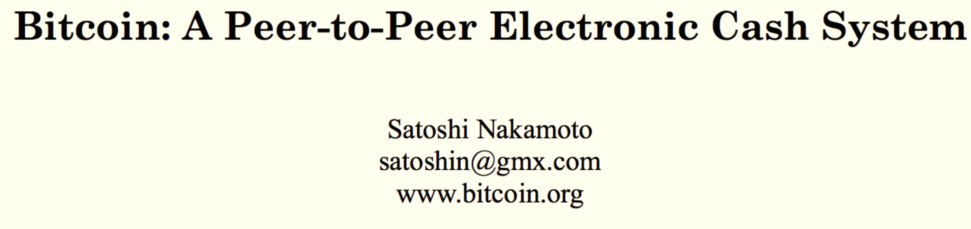

Slide 13

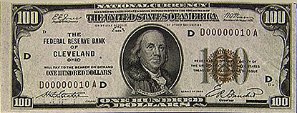
Bank IOU Protocol
High
Trust
Bank
Alice
{KU_{A}, KR_{A}}
M
E_{KRTB}[H(M)]
M = “The High Trust Bank owes the holder of this message $100.”
{KU_{TB}, KR_{TB}}

Slide 14
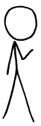
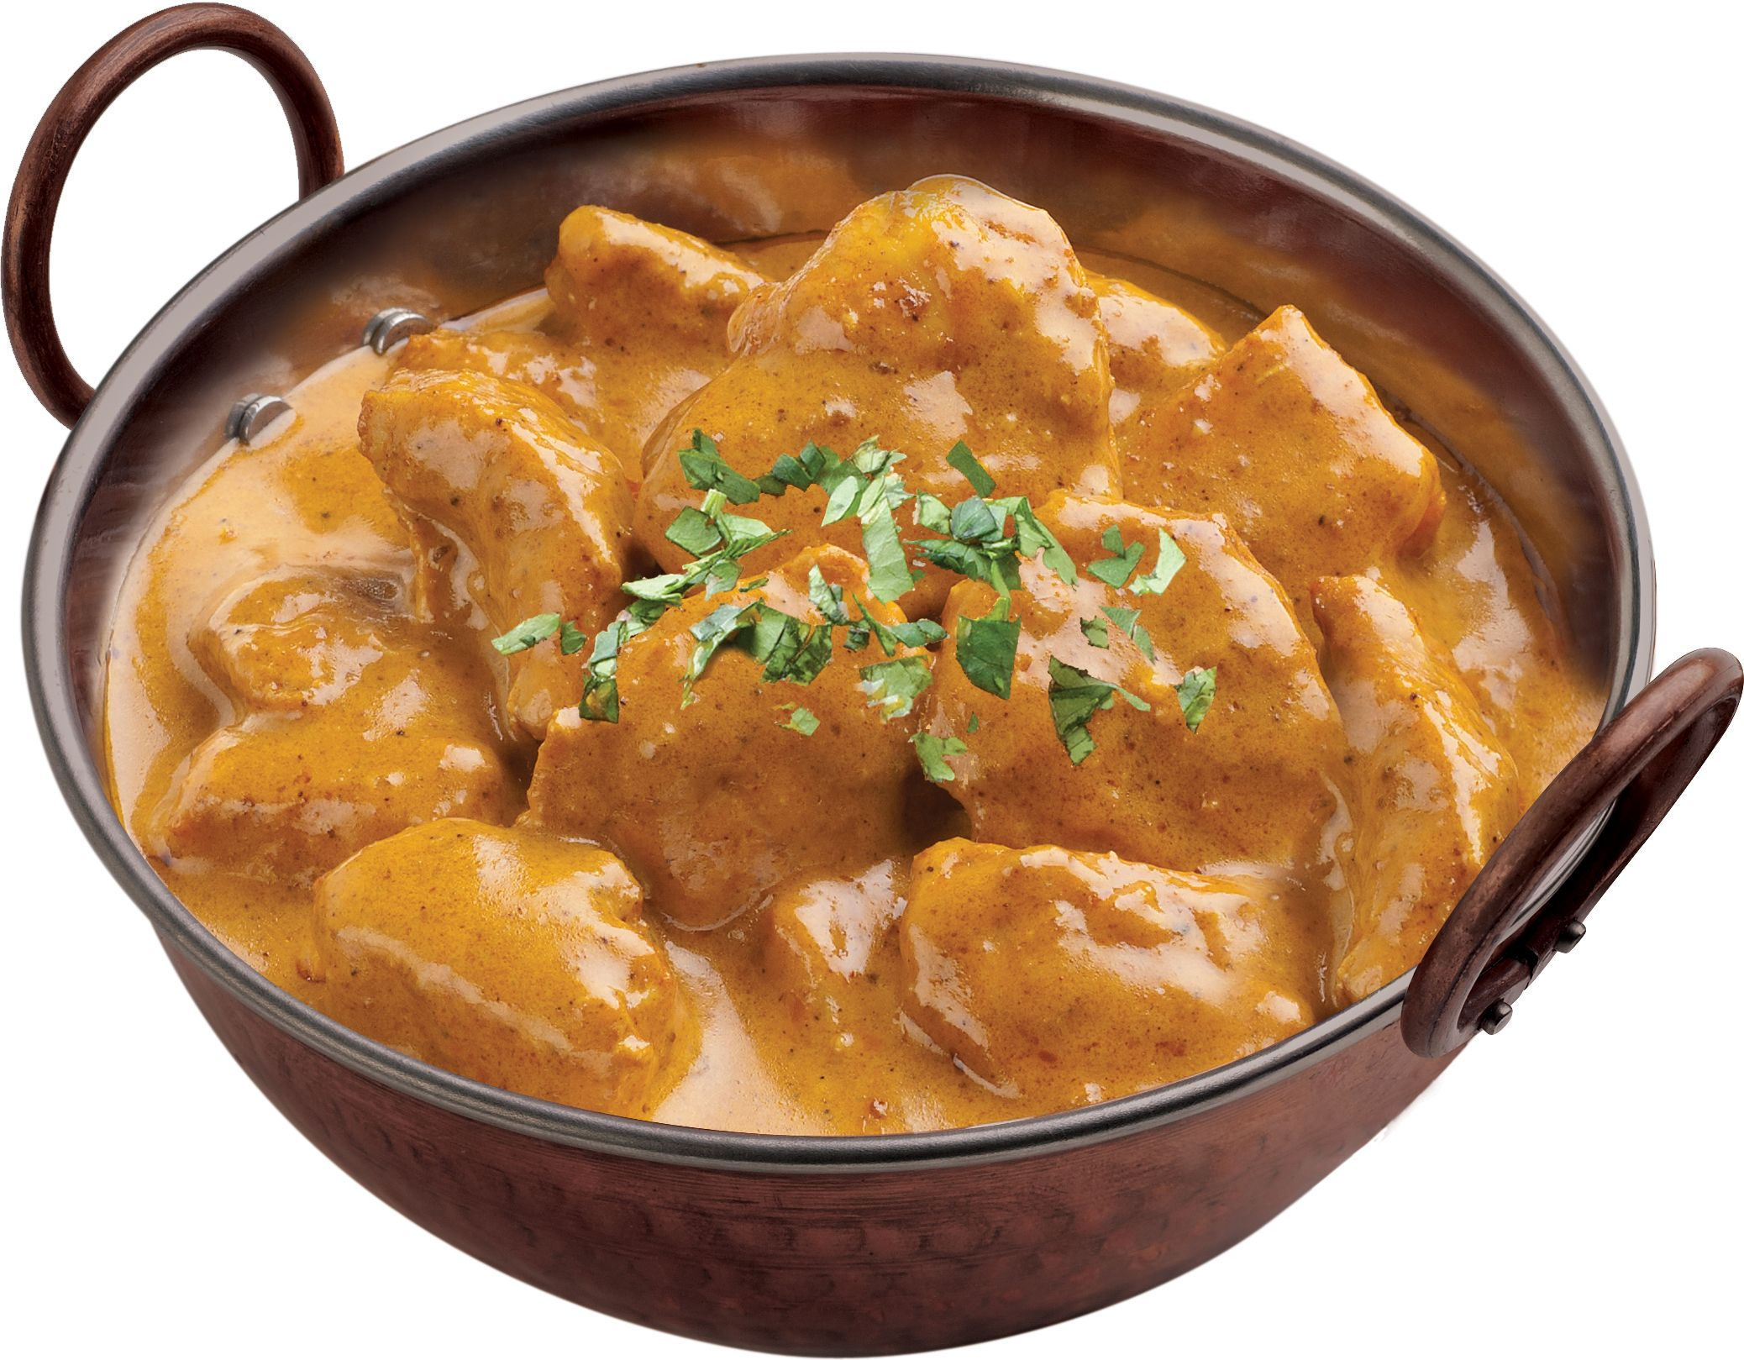
High
Trust
Bank
Alice
M
E_{KRTB}[H(M)]
Bob
M = “The High Trust Bank owes the holder of this message $100.”
{KU_{TB}, KR_{TB}}

Slide 15
High
Trust
Bank
Alice
M
E_{KRTB}[H(M)]
Bob
M
E_{KRTB}[H(M)]
M = “The High Trust Bank owes the holder of this message $100.”
{KU_{TB}, KR_{TB}}
E_{KUA}[secret curry recipe]

Slide 16
High
Trust
Bank
Alice
M
E_{KRTB}[H(M)]
Bob
M
E_{KRTB}[H(M)]
M = “The High Trust Bank owes the holder of this message $100.”
{KU_{TB}, KR_{TB}}
E_{KUA}[secret curry recipe]
M
E_{KRTB}[H(M)]

Slide 17
High
Trust
Bank
Alice
Both Alice and Bob can attempt to redeem the IOU (multiple times).
M
E_{KRTB}[H(M)]
Bob
M
E_{KRTB}[H(M)]
M = “The High Trust Bank owes the holder of this message $100.”
{KU_{TB}, KR_{TB}}
E_{KUA}[secret curry recipe]
M
E_{KRTB}[H(M)]

Slide 18
Add Unique Identifiers
Bear’s
Turns
Bank
M
E_{KRTB}[H(M)]
M = “Bill #51342: Bear’s Turns Bank owes the holder of this message $100.”
Alice
{KU_{TB}, KR_{TB}}
{KU_{A}, KR_{A}}

Slide 19
Add Unique Identifiers
Bill can only be redeemed once.
Bear’s
Turns
Bank
Bank cannot tell if it is Alice or Bob who cheated (first redeemer wins?)
M
E_{KRTB}[H(M)]
M = “Bill #51342: Bear’s Turns Bank owes the holder of this message $100.”
Alice
{KU_{TB}, KR_{TB}}
{KU_{A}, KR_{A}}
Not anonymous; tracable

Slide 20
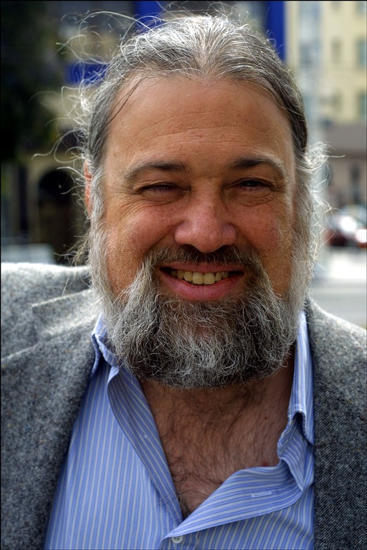
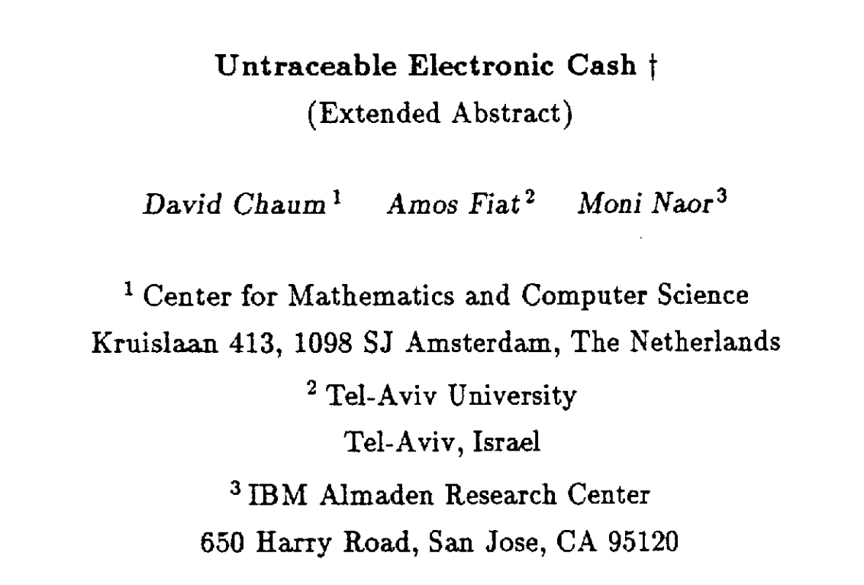

CRYPTO 1988
David Chaum
Photo: Declan McCullagh (2002)

Slide 21
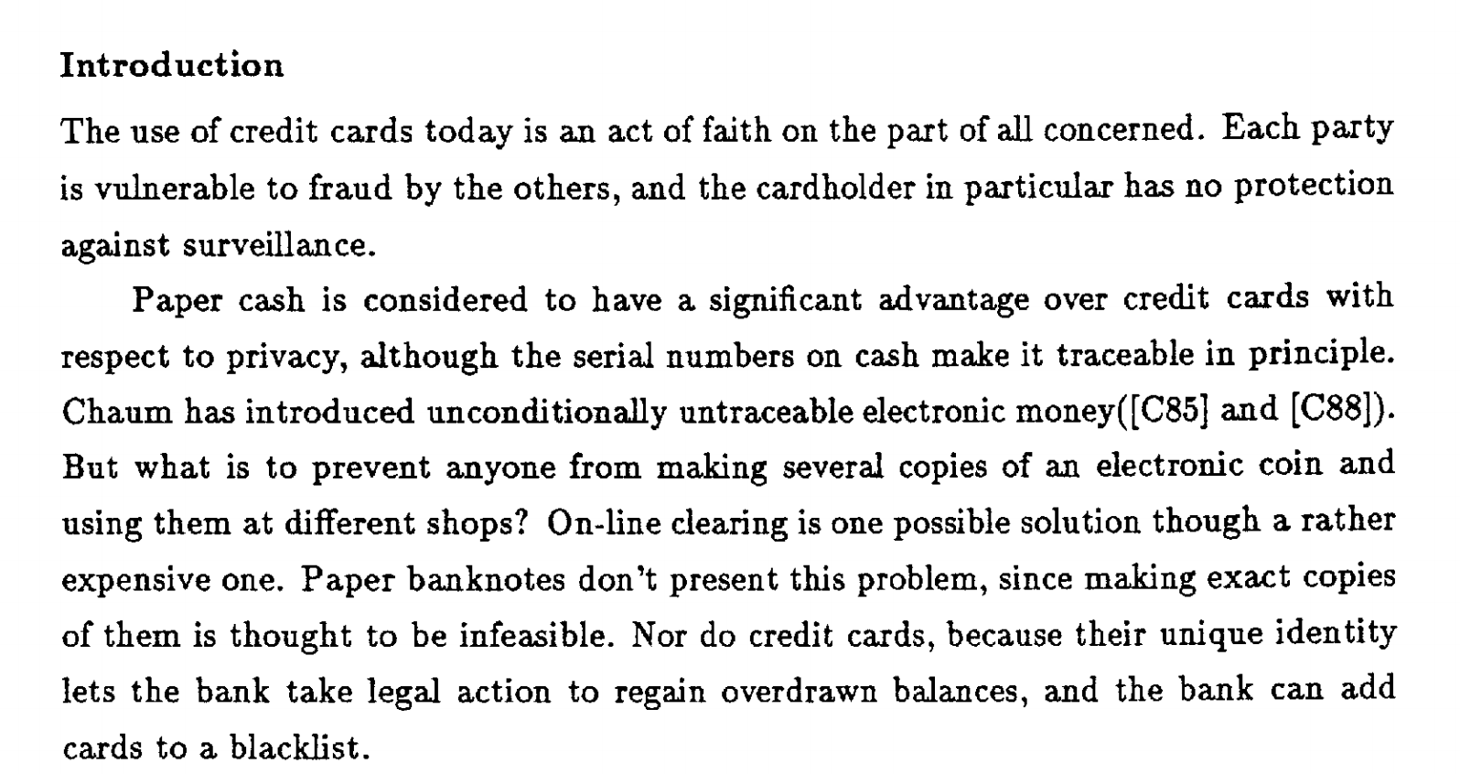

Slide 22
Key Technology: Blind Signatures
Bank’s public key: (e, n)
Bank’s private key: d
Blind Signatures:
Alice selects message m
Normal Signatures:
Alice selects message m
Sends m to bank
Bank returns signature:
S_{M} = m^{d} mod n

Slide 23
Key Technology: Blind Signatures
Bank’s public key: (e, n)
Bank’s private key: d
Blind Signatures:
Alice selects message m
Picks random k in [1, n)
Sends bank t = mk^{e} mod n
Bank signs:
t^{d} = (mk^{e} mod n)^{d} mod n
Alice computes m^{d} mod n:
= (mk^{e})^{d} mod n ≡ m^{d}k^{ed} mod n
divide by k = m^{d} mod n
Normal Signatures:
Alice selects message m
S_{M} = m^{d} mod n

Slide 24
Client-Selected Identifiers
M^{k}
Bear’s
Turns
Bank
E_{KRTB}[M^{k}]
M = “Bill #51342: Bear’s Turns Bank owes the holder of this message $100.”
{KU_{TB}, KR_{TB}}

Slide 25
Client-Selected Identifiers
M^{k}
Bear’s
Turns
Bank
E_{KRTB}[M^{k}]
M = “Bill #51342: Bear’s Turns Bank owes the holder of this message $10000000.”
{KU_{TB}, KR_{TB}}

Slide 26
Cut-and-Choose
M_{i} = “Bill #[r_{i}] : Bear’s Turns Bank owes the holder of this message $100.”
M₁^{k1}
M₂^{k2}
…
M₂₅₆^{k256}

Slide 27
Cut-and-Choose
M_{i} = “Bill #[r_{i}] : Bear’s Turns Bank owes the holder of this message $100.”
M₁^{k1}
M₂^{k2}
Alice generate N different messages, and blinds each with different k. Sends all of them to Bank.
…
Bank randomly selects N-1 of them, and challenges Alice to unblind.
M₂₅₆^{k256}
If all are okay, Bank (blindly) signs the one un-opened message, and returns it to Alice.

Slide 28
Cut-and-Choose
Alice generate N different messages, and blinds each with different k. Sends all of them to Bank.
M₁^{k1}
M₂^{k2}
Bank randomly selects N-1 of them, and challenges Alice to unblind.
…
If all are okay, Bank (blindly) signs the one un-opened message, and returns it to Alice.
M₂₅₆^{k256}
What is probability Alice can cheat without getting caught?

Slide 29
Add Unique Identifiers
Bill can only be redeemed once.
Bear’s
Turns
Bank
Bank cannot tell if it is Alice or Bob who cheated (first redeemer wins?)
M
E_{KRTB}[H(M)]
M = “Bill #51342: Bear’s Turns Bank owes the holder of this message $100.”
Alice
{KU_{TB}, KR_{TB}}
{KU_{A}, KR_{A}}
Not anonymous; tracable

Slide 30
Blinded Identifiers
Bill can only be redeemed once.
Bear’s
Turns
Bank
Bank cannot tell who cheated (first redeemer wins?)
M
E_{KRTB}[H(M)]
M = “Bill #51342: Bear’s Turns Bank owes the holder of this message $100.”
Alice
{KU_{TB}, KR_{TB}}
{KU_{A}, KR_{A}}
Anonymous and untraceable

Slide 31
Catching Cheaters
M
E_{KRTB}[H(M)]
M
E_{KRTB}[H(M)]
Bear’s
Turns
Bank
Spend a bill once: anonymity preserved
M
E_{KRTB}[H(M)]
Spend a bill twice: identity revealed

Slide 32
Identity Strings
I = “alice@alice.org”
M_{i} = “Bill #[r_{i}] : Bear’s Turns Bank owes the
holder of this message $100.”
+ identity strings:
I₁ = (h(I_{1L}), h(I_{1R}))
...
I_{n} = (h(I_{nL}), h(I_{nR}))
where h is a one-way hash function and each I_{iL} ⊕ I_{iR} = I
M₁^{k1}
M₂^{k2}
…
M₂₅₆^{k256}

Slide 33
Spending a Bill
M
E_{KRTB}[H(M)]
I = “alice@alice.org”
M_{i} = “Bill #[r_{i}] : Bear’s Turns Bank owes the
holder of this message $100.”
+ identity strings:
I₁ = (h(I_{1L}), h(I_{1R}))
...
I_{n} = (h(I_{nL}), h(I_{nR}))
where h is a one-way hash function and each I_{iL} ⊕ I_{iR} = I
Reveal request: LRRLRLR…
(randomly select L or R for each pair)
I_{1L}, I_{2R},I_{3R}, I_{4L},…
verifies hashes,
accepts bill

Slide 34
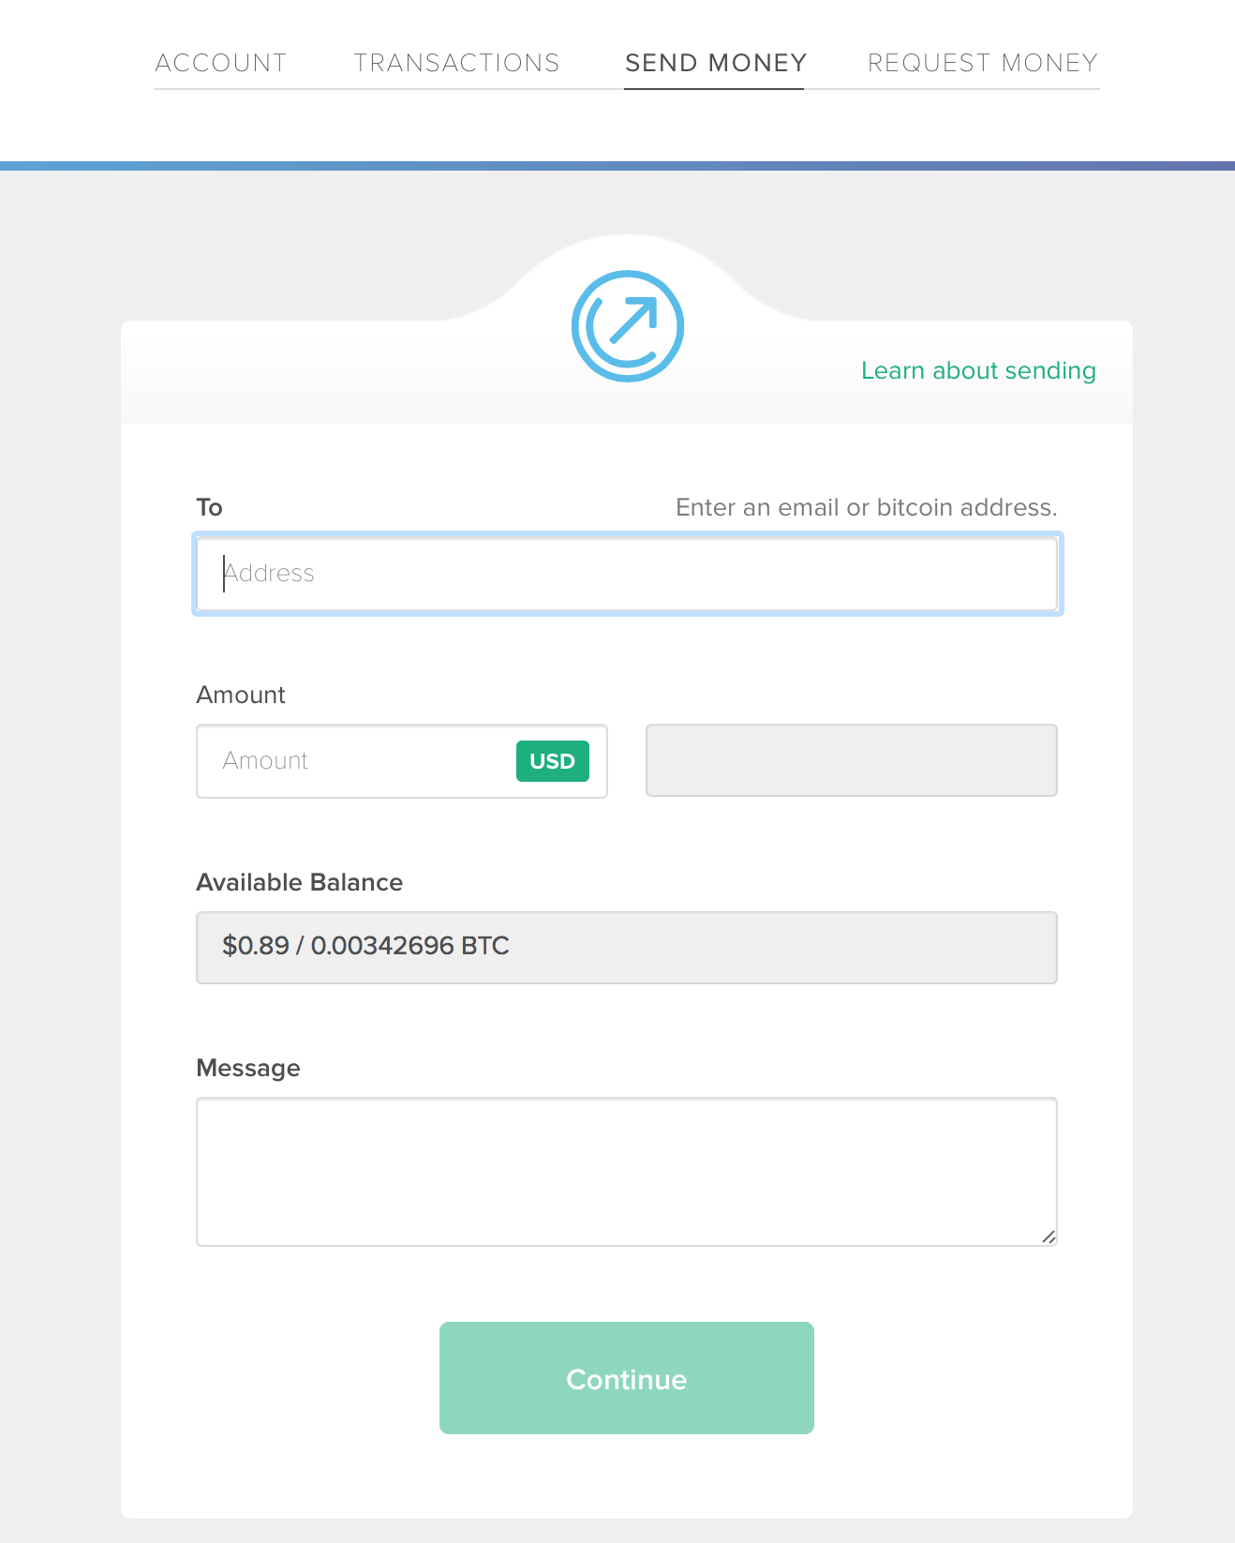
How well does this scheme work as a currency?

Slide 35
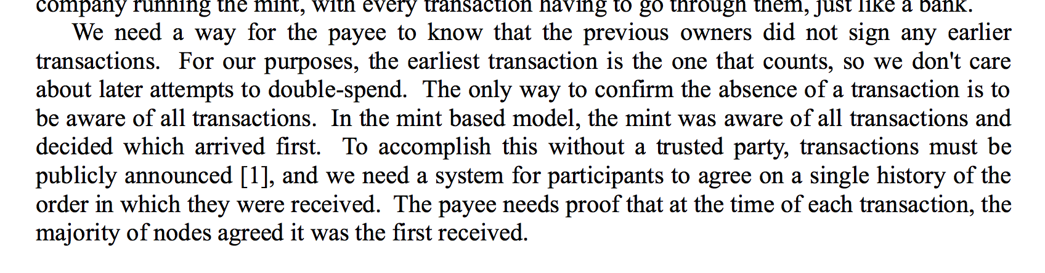
Bitcoin’s solution: a public ledger

Slide 36
Public Ledger
Node A
Node B
Node C
Bob wants to verify:
Alice hasn’t already transferred X
The coin will be valuable for Bob
M = transfer X to Bob
E_{KRA}[H(M)]

Slide 37
Public Ledger: Distributed Trust (?)
Node A
Node B
Node C
t_{b}
t_{b}
t_{b}
Bob wants to verify:
Alice hasn’t already transferred X
The coin will be valuable for Bob
M = transfer X to Bob
E_{KRA}[H(M)]
t_{b}

Slide 38
Transactions
1 | t_{b} (X->Bob)
Transactions
1 | t_{b} (X->Bob)
t
Node A
Node B
Node C
ok!
t_{b}
t_{b}
t_{b}
ok!
Bob wants to verify:
Alice hasn’t already transferred X
The coin will be valuable for Bob
M = transfer X to Bob
E_{KRA}[H(M)]
t_{b}

Slide 39
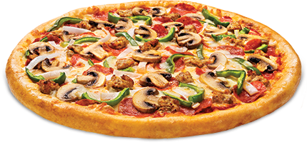
Transactions
1 | t_{b} (X->Bob)
Transactions
1 | t_{b} (X->Bob)
t
Node A
Node B
Node C
ok!
t_{b}
t_{b}
t_{b}
ok!
t_{b}
Bob wants to verify:
Alice hasn’t already transferred X
The coin will be valuable for Bob

Slide 40
Transactions
1 | t_{b} (X->Bob)
Transactions
1 | t_{c} (X->Cathy)
Transactions
1 | t_{b} (X->Bob)
t
Node A
Node B
Node C
BAD!
t_{c}
t_{c}
t_{c}
M = transfer X to Cathy
E_{KRA}[H(M)]
t_{c}

Slide 41
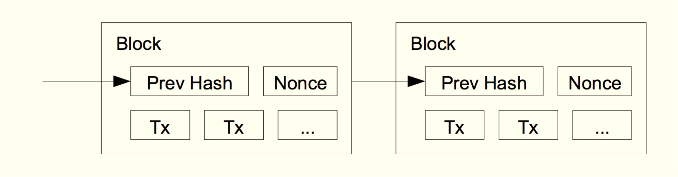
Blockchain
Public ledger without fixed set of nodes – decentralized, distributed trust
Requires coalition with majority of computing power to collude to cheat

Slide 42
Charge
Next week: The Blockchain
Project 1 is due Friday
Upcoming office hours:
Me: Thursday 4-5pm (Rice 507)
Nick: Friday noon-2pm (HackCville)

